Slide 1

Computer Architecture Experiment
Lab4
姜晓红
College of Computer Science & Engineering
Zhejiang University

Slide 2
Topics
0、Basic Knowledge
1、Function Units Design
2、Single-cycle CPU Design
3、Multiple-cycle CPU Design
4、5-stage of pipeline CPU Design
5、Pipelined CPU with stall
6、Pipelined CPU with forwarding
7、Pipelined CPU resolving control hazard
8、Pipelined CPU support execution 16 MIPS Instructions
9、Course Review

Slide 3
Outline
Experiment Purpose
Experiment Task
Basic Principle
Operating Procedures
Precaution

Slide 4
Experiment Purpose
Understand the principles of Pipelined CPU
Understand the basic units of Pipelined CPU
Understand the working flow of 5-stages
Master the method of simple Pipelined CPU
master methods of program verification of simple Pipelined CPU

Slide 5
Experiment Task
Design the CPU Controller
Based on the CPU Controller, Design the Datapath of 5-stages Pipelined CPU
  5 Stages
  Register File
  Memory (Instruction and Data)
  other basic units
Verify the Pp. CPU with program and observe the execution of program

Slide 6
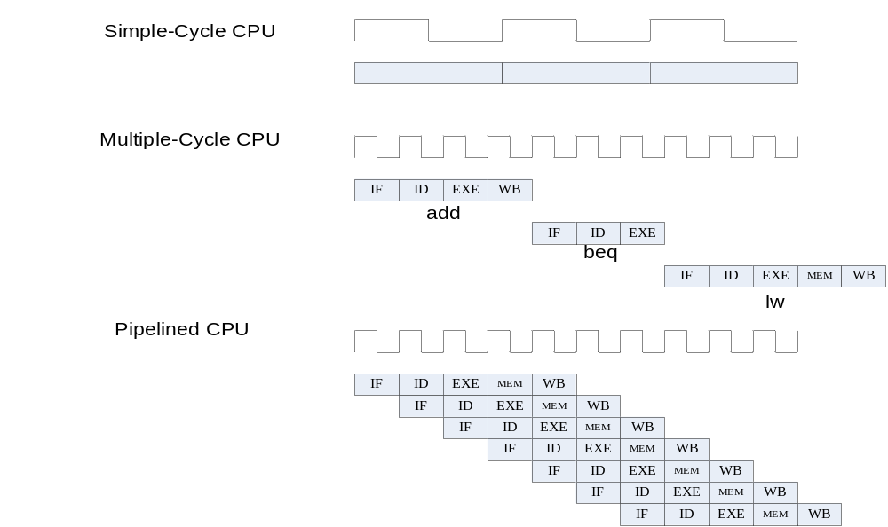
Comparison of three CPUs’ work

Slide 7
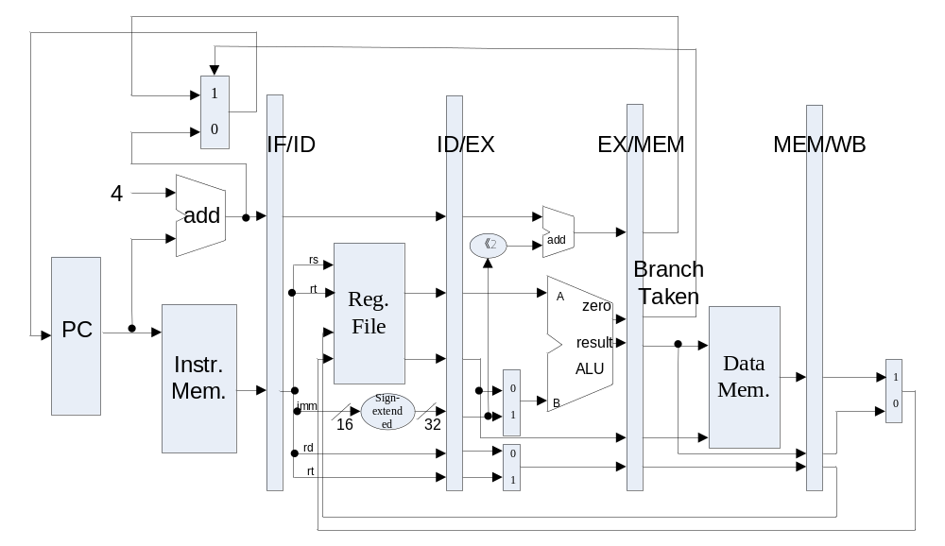
Datapath of 5-stages Pipelined CPU

Slide 8
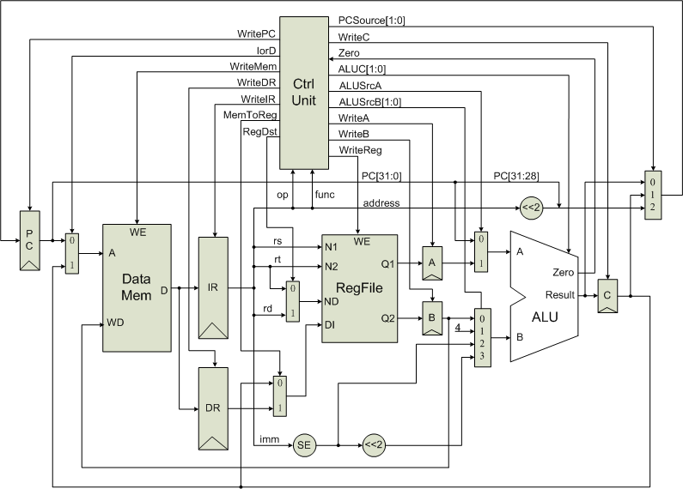
The principle of Multiple-cycle CPU

Slide 9
Structural hazards －resource conflicts
Structural hazards arise from resource conﬂicts when the hardware cannot support all possible combinations of instructions in simultaneous overlapped execution.
  Memory conflicts
  Register File conflicts
  Other units conflicts

Slide 10
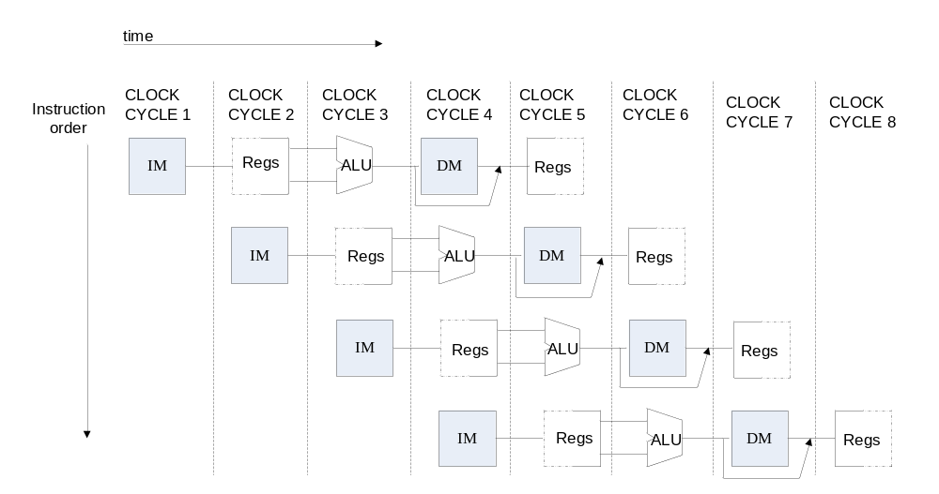
How to resolve Structural hazards

Slide 11
Register File
Register File
  Positive edge for transfer data for stages
  Negative edge for write operation
  Low level for read operation

Slide 12
Memory
Instruction Memory
  Single Port Block Memory
  Read only, Width:32
  Falling Edge Triggered
Data Memory
  Single Port Block Memory
  Read and write, Width:32
  Falling Edge Triggered

Slide 13
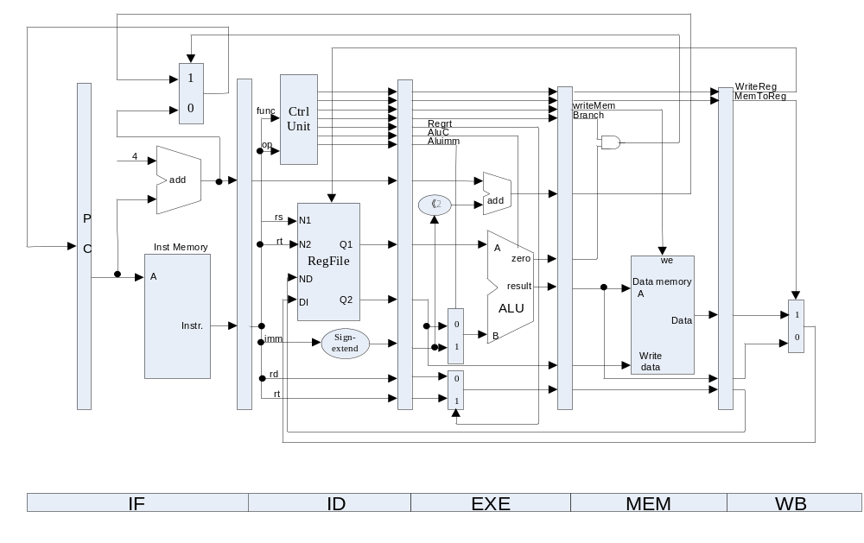
The principle of Pipelined CPU－with CPU controller

Slide 14
Output of CPU Controller
 | Output Signal | Meaning When 1 | Meaning When 0
1 | Cu_branch | Branch Instr. | Non-Branch Instr.
2 | Cu_shift | sa | Register data1
3 | Cu_wmem | Write Mem. | Not Write Mem.
4 | Cu_Mem2Reg | From Mem. To Reg | From ALUOut To Reg
5 | Cu_sext | Sign-extend the imm. | No sign extended the imm.
6 | Cu_aluc | ALU Operation
7 | Cu_aluimm | Imm. | Register data2
8 | Cu_wreg | Write Reg. | Not Write Reg.
9 | Cu_regrt | rt | rd

Slide 15
Units of Pipelined-cycle CPU
IF Stage (Instr. Mem.)
ID Stage (CPU Ctl. And R.F.)
EX Stage (ALU)
Mem Stage (Data Mem.)
WB Stage

Slide 16
Pipelined CPU Top Module
module top (input wire CCLK, BTN3, BTN2, input wire [3:0]SW, output wire LED, LCDE, LCDRS, LCDRW, output wire [3:0]LCDDAT);
assign pc [31:0] = if_npc[31:0];
if_stage x_if_stage(BTN3, rst, pc, mem_pc, mem_branch, …
IF_ins_type, IF_ins_number,ID_ins_type,ID_ins_number);
id_stage x_id_stage(BTN3, rst, if_inst, if_pc4, wb_destR,…
ID_ins_type, ID_ins_number, EX_ins_type, EX_ins_number..);
ex_stage x_ex_stage(BTN3, id_imm, id_inA, id_inB, id_wreg, ..
EX_ins_type, EX_ins_number, MEM_ins_type, MEM_ins_number);
mem_stage x_mem_stage(BTN3, ex_destR, ex_inB, ex_aluR, …
MEM_ins_type, MEM_ins_number, WB_ins_type, WB_ins_number);
wb_stage x_wb_stage(BTN3, mem_destR, mem_aluR, …
WB_ins_type, WB_ins_number,OUT_ins_type, OUT_ins_number);

Slide 17
Observation Info
Input
  West Button: Step execute
  South Button: Reset
  4 Slide Button: Register Index
Output
  0-7 Character of First line: Instruction Code
  8 of First line : Space
  9-10 of First line : Clock Count
  11 of First line : Space
  12-15 of First line : Register Content
  Second line : “stage name”/number/type
  stage name: 1-”f”, 2-”d”, 3-”e”, 4-”m”, 5-”w”

Slide 18
Program for verification
 | Instruction | Bin Code | Address | Inst. Type
 | lw r1, $20(r0) | 0x8c01_0014 | 0 | 6
 | lw r6, $21(r0) | 0x8c06_0015 | 1 | 6
 | add r3,r0,r0 | 0x0000_1820 | 2 | 1
 | add r4,r0,r0 | 0x0000_2020 | 3 | 1
 | add r5,r0,r0 | 0x0000_2820 | 4 | 1
 | add r2,r2,r1 | 0x0041_1020 | 5 | 1
 | sub r3, r3, r1 | 0x0061_1822 | 6 | 2
 | and r4, r4, r1 | 0x0081_2024 | 7 | 3
 | nor r5, r5, r1 | 0x00a1_2827 | 8 | 5
 | beq r2, r1, -8 | 0x1041_fff8 | 9 | 8

Slide 19
Precaution
1. Add Anti-Jitter and display for “A-F”.
2. Finish the blank.
3. Debug method: Output whatever signal to LCD Display.
4. Understand the principle of pipelined CPU and check the logic of circuit carefully, understand the sample code, then write code and synthesize the project, because it takes you a few minutes…

Slide 20
Something Important ! ! !
1、The number and type are mean for the instruction which is to be executed in the stage.
2、How to verify the result? Pls. check the result of WB stage for R-type and LW instructions, while check the result of EXEC stage for BEQ instruction.
3、Why there are some NONE instructions following BEQ? How many NONE instructions? 3, because the condition of BEQ is generated in MEM stage.
4、Why the initial value of PC is FFFFFFFF, not 0?
5、Why we should pull the slide button after step execution to refresh the result? And instruction refresh is delayed by 1 clock-cycle? How to refresh automatically?

Slide 21
Thanks!

